Slide 1
Network Programming
Odongo Steven Eyobu, Ph.D
odongo.eyobu@mak.ac.ug

Slide 2

Dynamic Adaptive Streaming over HTTP
DASH: Dynamic Adaptive Streaming over HTTP.
MPEG-DASH: Most popular online video streaming protocols
Based on ABR (Adaptive bit rate streaming)
Uses a rendition of multiple bit rates and resolutions
Eg. (1080p 5.0 mbps, 720p 4.0 mbps, 640p 3.2 mbps, 480p 2.0 mbps, 270p 1 mbps)
Also called a bit-rate ladder
Depends on continous sensing of the channel bandwidth to determine the which part of the chunk to transmit.

Slide 3
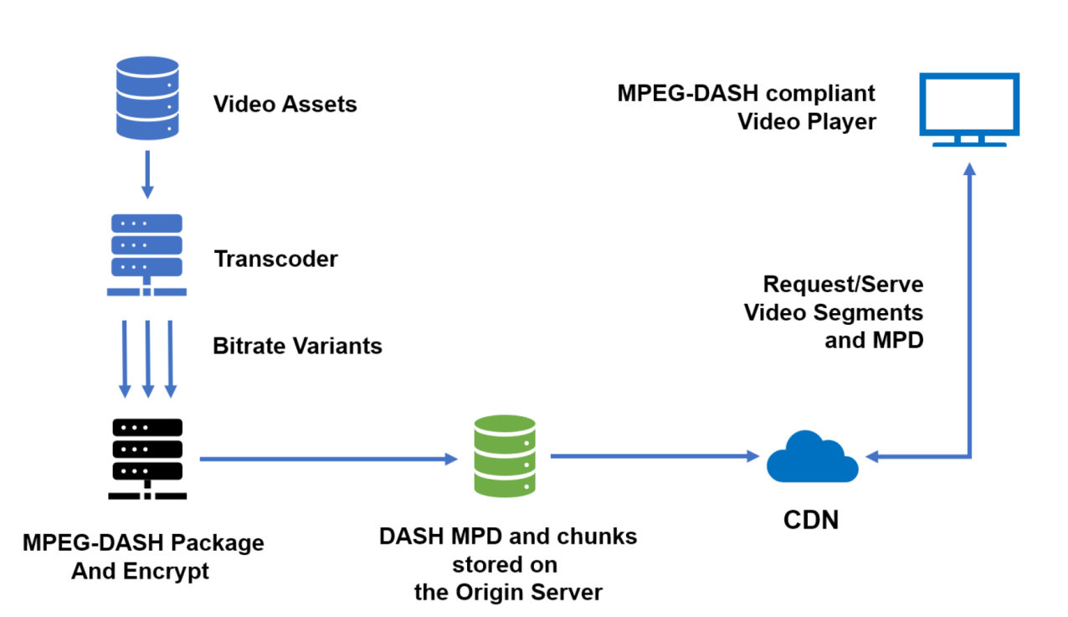
Dynamic Adaptive Streaming over HTTP
Adopted from: https://ottverse.com/mpeg-dash-video-streaming-the-complete-guide/

Slide 4
Dynamic Adaptive Streaming over HTTP
PROJECT 2
Build a Dash video streaming protocol.
Deliverable:
A high performance live video streaming online channel.

